Slide 1
RAJALAKSHMI ENGINEERING COLLEGE
Department of Artificial Intelligence and Machine Learning
AI19611 - MINI PROJECT
AGRISENCE – A SMART FARMING SYSTEM FOR OPTIMIZED IRRIGATION , FERTILIZER PREDITION AND YEILD FORECASTING
Project by,
ARUNKUMAR M (221501013)
DEEPENDRA S (221501025).

Slide 2
OUTLINE
Abstract
Objectives
Problem Solution
Methodology
Architectural Design For Proposed System
Results and Discussions
Conclusion
References

Slide 3
Agrisence is an intelligent farming system designed to assist farmers in improving agricultural productivity using AI technologies. The system integrates Machine Learning and Deep Learning to predict optimal irrigation schedules, recommend the right fertilizers for different crops, and forecast yield accurately. By leveraging image data and environmental inputs, Agrisence aims to promote data-driven farming, reduce resource wastage, and enhance crop management practices.
ABSTRACT

Slide 4
→Automate irrigation recommendations based on soil moisture, weather, and crop type. →Predict the best fertilizer type using crop image data. →Forecast crop yield using historical and real-time features. →Provide a unified smart farming platform for decision support.
OBJECTIVE

Slide 5
Problem Statement: Farmers often rely on traditional knowledge, leading to over/under-irrigation and inappropriate fertilizer use. Crop yield forecasting is unreliable without data-driven methods. Proposed Solution: An AI-driven system that: Suggests precise irrigation needs. Recommends fertilizers using crop images (Deep Learning). Forecasts yield using ML regression models.
PROBLEM SOLUTION

Slide 6
METHADOLOGY
→Data Collection:
Crop images (Rice, Sugarcane, Jute, etc.)
Weather and soil data
Historical yield datasets
→Data Preprocessing:
Image augmentation and normalization
Handling missing values in tabular data
→Model Training:
→Fertilizer Prediction: CNN model on crop images
→Irrigation Prediction: ML model using weather and soil moisture data
→Yield Forecasting: Regression model (e.g., Random Forest/Linear Regression)
→Model Evaluation:
Accuracy, F1 Score, MAE, RMSE depending on the task

Slide 7
ARCHITECTURAL DESIGN FOR PROPOSED SYSTEM
User interface
Data Acquisition
Data Preprocessing
Recommendations
Decision Support
System
Machine Learning & Deep Learning Models

Slide 8
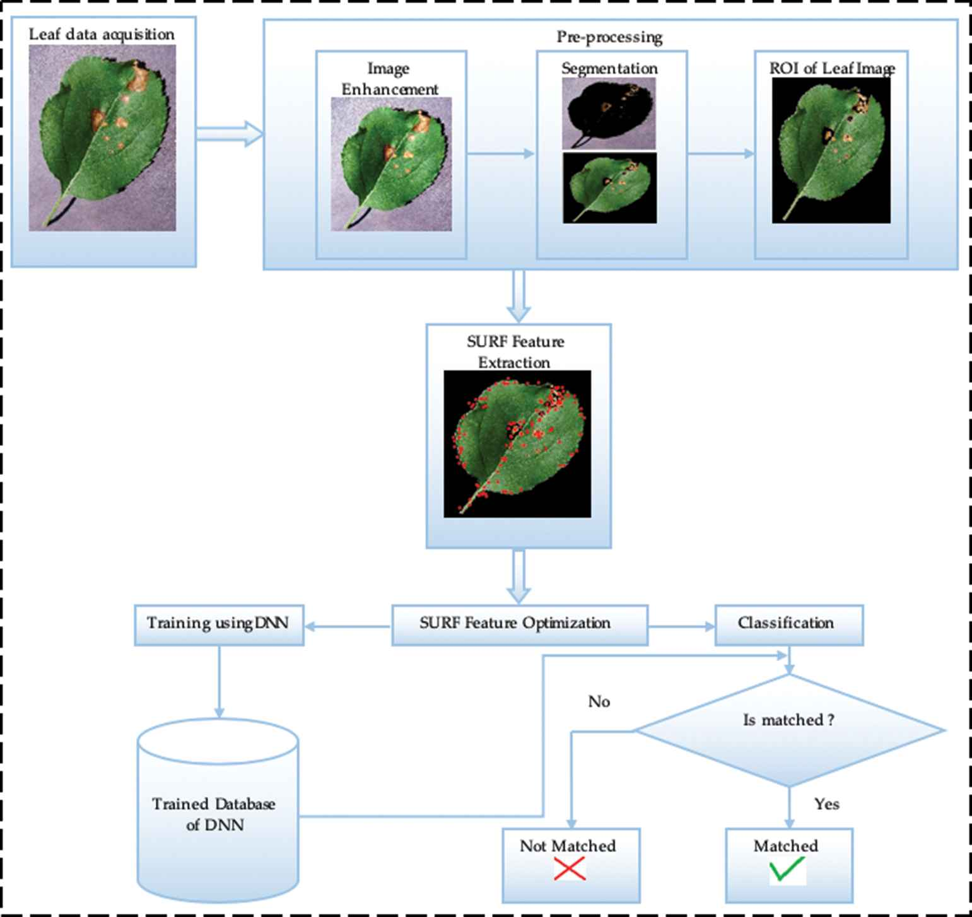
ARCHITECTURAL DESIGN FOR PROPOSED SYSTEM

Slide 9
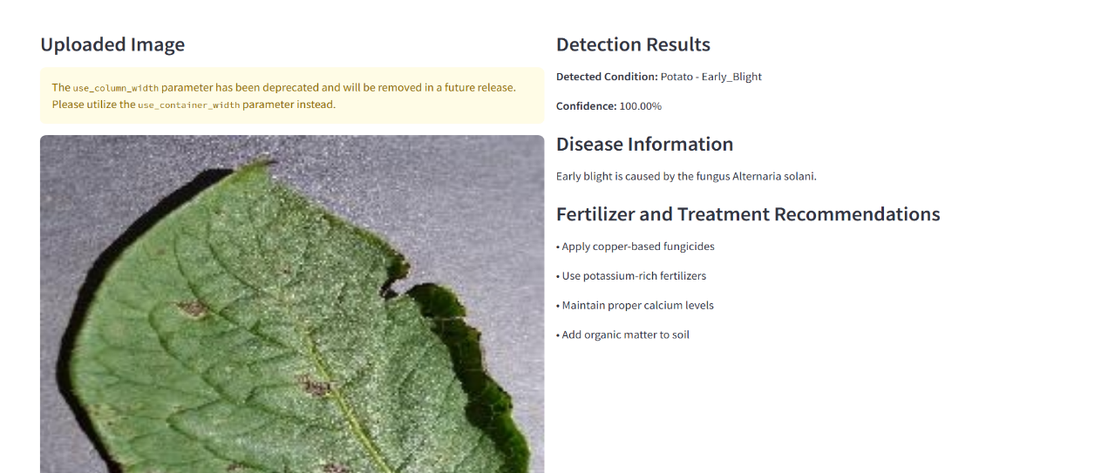
ARCHITECTURAL DESIGN FOR PROPOSED SYSTEM
Date:22/12024
9

Slide 10
Results and Discussions
Fertilizer Prediction Accuracy: ~90% using CNN model
Irrigation Recommendation Precision: Based on soil moisture thresholds
Yield Forecasting RMSE: ~10-15% error range
Real-world test cases show improvement in resource efficiency

Slide 11
Conclusion
Agrisence demonstrates how AI can revolutionize farming by optimizing core agricultural decisions. The integration of ML and DL models enables smarter irrigation, better fertilizer usage, and reliable yield forecasts. Future work includes integrating drone imagery and real-time IoT-based sensors for enhanced precision.

Slide 12
REFERENCES
[1] Dishay Kissoon, Hinouccha Deerpaul and Avinash Mungur, “A Smart Irrigation and Monitoring System”, The International Journal of Computer Applications, vol. 163, No. 8, Apr. 2017.
[2] NIC IN. annual report 2020-21. https://agricoop.nic. in/Documents/annual-report-2020-21, 2023. [Online; accessed Jan. 20, 2023].
[3] Govt, India. Crop production statistics information system. https://aps.dac.gov.in/APY/Index.htm, 2023.
[4] M Khan and S Noor. Performance analysis of regression- machine learning algorithms for predication of runoff time. Agrotechnology, 08 (01):1–12, 2019.

Slide 13
THANK YOU

